Slide 1
Intro to R for Biologists Session 1 R basics
Irina & Rao
Michaelmas 2021

Slide 2
Vevox
GitHub account
Screen sharing

Slide 3
Intro to R for biologists
Basic concepts
Your R environment
Getting help
Assignment to variables
Data types
Data structures
Subsetting
Conditionals
Loops
Functions
Packages/libraries

Slide 4
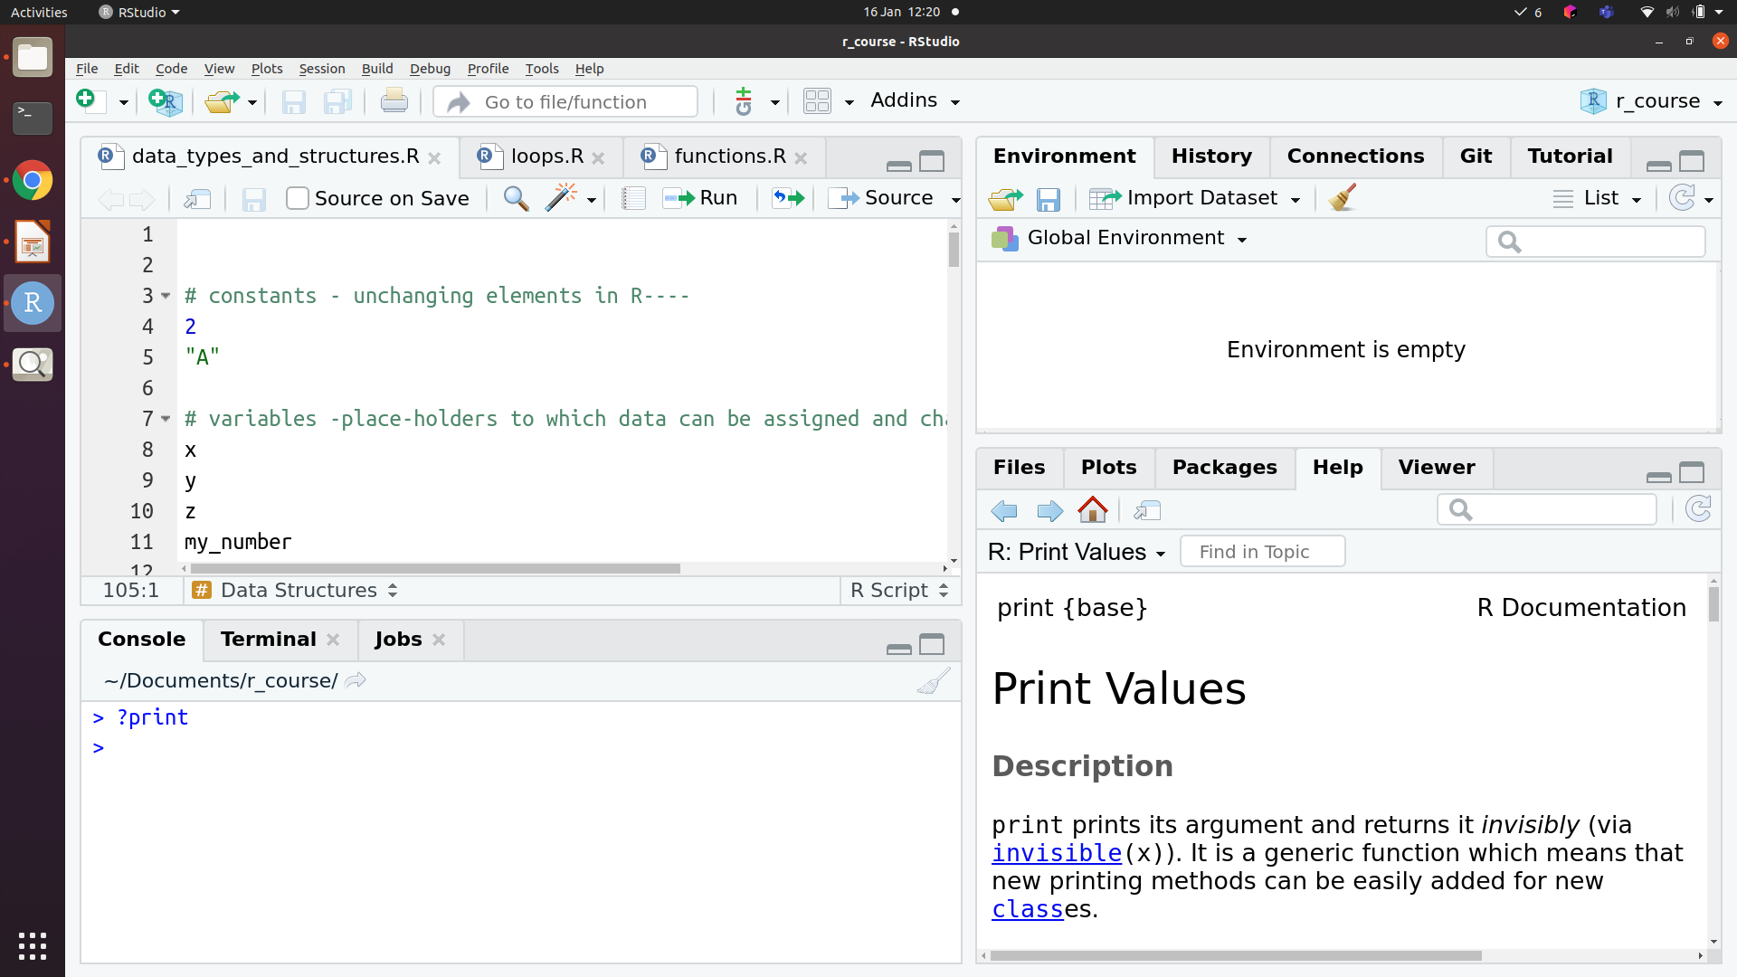




Your R (Rstudio) environment
Script
Environment / History
Help / Plots /
Files
Console
Script
Console
Help/Plots/Files
Environment/History

Slide 5

Let’s explore practically

Slide 6
Constants vs. variables
Constants vs variables
Constants are unchanging
Pi, Avogadro’s number
Variables are placeholders
x = 10, y = 20; x + y = 30

Slide 7
How to get help
? and ??
Google!
help()

Slide 8
Assignment of data to variables
The ‘arrow’: x <- 2
Equals sign: x = 2

Slide 9
Let’s explore practically

Slide 10
Data types in R
Character
“a”, “apple”
Numeric
1, 23, 3.14
Logical
TRUE, FALSE (also 1, 0 or T, F)
Factor
For categorical variables, when data is classified into groups
Quotations
‘’ “” – denote character or string data

Slide 11
Conversion (and coercion)
as.character()
Numeric, logical and factor types can be converted to character
as.numeric()
Logical, and character variables that are purely numbers can be converted to numeric
as.logical()
“FALSE” or 0 is converted to FALSE, “TRUE” or any non-zero number is converted to TRUE
as.factor()
Any other data type can be converted to a factor
Warnings
Silent effects
Warning message:
NAs introduced by coercion
> as.numeric(as.character(14))
[1] 14
> as.numeric(as.factor(14))
[1] 1

Slide 12
Let’s explore practically

Slide 13
Data Structures: atomic vector
atomic vector
All elements are of the same type
1
2
3
4
1
2
3
4
1
2
3
4
atomic vector
“a”
“a”
“c”
“f”
1
2
1
4
T
F
T
T

Slide 14
Data Structures: matrix
matrix
All elements are of the same type, data organised in rows and columns
1
2
3
4
1
2
3
4
1
2
3
4
1
1
1
matrix
2
2
2
3
3
3

Slide 15
Data Structures: data.frame
data.frame
Data organised into rows and columns; elements of each column are of the same type, but different columns can be of different types
1
2
3
4
1
data.frame
2
3

Slide 16
Data Structures: list
list
Elements can be different types, elements can also be other data structures
1
2
3
4
1
2
3
1
2
3
4
1
2
3
4
1
1
2
3
4
1
list
“a”
“a”
“c”
“f”
2
T
F
T
T
2
3
3

Slide 17
1
2
3
4
1
2
3
4
1
2
3
4
atomic vector
“a”
“a”
“c”
“f”
1
2
1
4
T
F
T
T
1
2
3
4
1
2
3
4
1
2
3
4
1
1
1
matrix
2
2
2
3
3
3
A data.frame is actually a list! (where each element of the list is an atomic vector of equal length)
1
2
3
4
1
1
2
3
4
data.frame
2
3
1
2
3
4
1
2
3
1
2
3
4
1
2
3
4
1
1
2
3
4
1
list
“a”
“a”
“c”
“f”
2
T
F
T
T
2
3
3

Slide 18
Subsetting R objects
[ ] – To get a subset of elements
[[ ]] – To get a specific element from a list (or a column of a data.frame)
$ - To subset a specific column in a data.frame

Slide 19
Subsetting R objects
1
2
3
4
My_av[2]
2
My_av
“a”
“a”
“c”
“f”
My_av[c(F, T, F, F)]
“a”
1
2
3
4
1
My_mat[2, ]
My_mat
2
3
My_mat[ , 2]

Slide 20
Subsetting R objects: list
1
2
3
4
1
2
3
1
2
3
4
1
2
3
4
1
1
2
3
4
1
My_list
“a”
“a”
“c”
“f”
2
T
F
T
T
2
3
3
1
3
4
1
2
3
4
1
2
3
4
1
2
3
4
1
My_list[1]
“a”
“a”
“c”
“f”
My_list[3:4]
T
F
T
T
2
3
1
2
3
4
My_list[[1]]
“a”
“a”
“c”
“f”

Slide 21
Subsetting R objects: data.frame
Column names
Gene_name
Alt_name
Gene_count
Gene_id
Row
names
1
2
3
4
S1
1
My_df[3, ]
My_df
S2
2
My_df[“S3”, ]
S3
3
My_df[ , 3]
My_df[ , “Gene_count”]
My_df$S3
My_df[[“Gene_count”]]

Slide 22
Let’s explore practically

Slide 23
Math operations
Add, subtract, divide, multiply
+ - / *
Modulo (remainder of division)
%%
Exponent
^
Rounding
round(), floor(), ceiling()

Slide 24
Comparisons
Comparison between two objects returns TRUE or FALSE or NA
== (Note the difference between this and = for assignment)
<
>
<=
>=
!= (Negation of anything in R is done with !)
%in%

Slide 25
Comparing integers with characters
?Comparison
If the two arguments are atomic vectors of different types, one is coerced to the type of the other, the (decreasing) order of precedence being character, complex, numeric, integer, logical and raw.
x <- "c”
x > 1000
TRUE
y <- “i”
x > y
FALSE
z <- "A”
x > z
TRUE
Note: A character is smaller than another if it comes first in alphabetical order.
Similar to sorting your Excel sheet:
If you sort ascending -> numbers come first, then all the rest alphabetically

Slide 26
Logical operators (Boolean operations)
!x Logical NOT
x&y Element-wise logical AND
x&&y Logical AND
x|y Element-wise logical OR
x||y Logical OR
Note: Zero is considered as FALSE,
non-zero values are considered as TRUE!
Only “numeric-like” or logical vectors!
x <- c(TRUE, FALSE, 0, 6)
y <- c(FALSE, TRUE, FALSE, TRUE)
!x
FALSE TRUE TRUE FALSE
x&y
FALSE FALSE FALSE TRUE
x&&y
FALSE
x|y
TRUE TRUE FALSE TRUE
x||y
TRUE

Slide 27
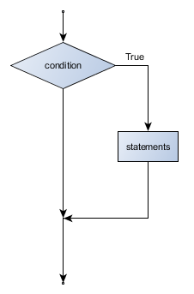
Conditionals if statement
if(TRUE or FALSE) {
Do something
}
x <- 4
if(x > 0) {
print("Positive number")
}
x <- -4

Slide 28
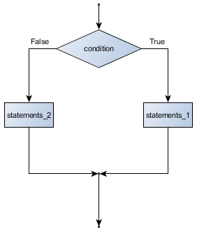
Conditionals if … else statement
if(TRUE or FALSE) {
Do something
} else {
Do some other thing
}
else block
If block
x <- 4
if(x > 0) {
print("Positive number")
} else {
print(”Not positive number")
}
x <- -4

Slide 29
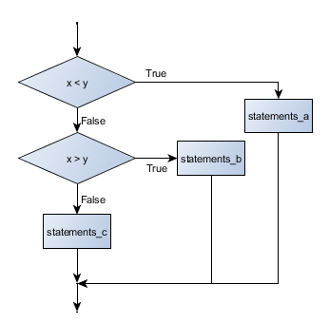
Chained conditionals if … else if … else
if (x < y) {
STATEMENTS_A
} else if (x > y) {
STATEMENTS_B
} else {
STATEMENTS_C
}
x <- 0
if (x < 0) {
print("Negative number")
} else if (x > 0) {
print("Positive number")
} else {
print("Zero")
}

Slide 30

Let’s explore practically

Slide 31
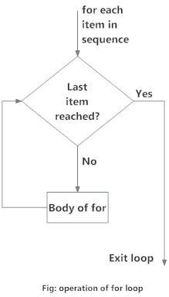
Loops for
for (val in sequence)
{
statement
}
for (year in c(2011,2012,2013,2014,2015,2016))
{
print(paste("The year is", year))
}

Slide 32
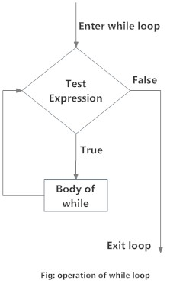
Loops while
while (test_expression)
{
statement
}
i <- 1
while (i < 6) {
print(i)
i = i+1
}

Slide 33
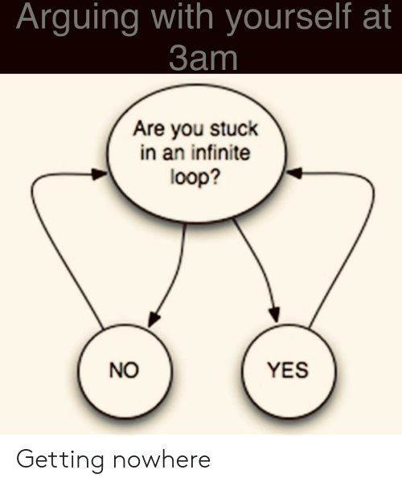
Infinite loops
x <- 1
while (x=1)
{
Print(“Let’s move on!”)
}
Something to keep in mind!
*break and next statements might help –
advanced level

Slide 34
Let’s explore practically

Slide 35
Functions
Functions are created using the function() directive and are stored as R objects just like anything else. In particular, they are R objects of class “function”.
f <- function(<arguments>) {
## Do something interesting
}
Note: majority of the functions you would try to create already exist in the libraries!

Slide 36
Packages/libraries
A package is a collection of R functions, data and compiled code. The location where the packages are stored is called the library.
Package extends basic R functionality and standardizes the distribution of code. For example, a package can contain a set of functions relating to a specific topic or tasks.

Slide 37
Where to get the libraries/packages?
CRAN (https://cran.r-project.org)
Install:
install.packages("dplyr")
Activate:
Library("dplyr")
Bioconductor (https://bioconductor.org)
if (!requireNamespace("BiocManager", quietly = TRUE))
install.packages("BiocManager”)
BiocManager::install("limma")
Github (https://github.com)
install.packages("devtools")
library(devtools)
install_github("hadley/dplyr”)

Slide 38
Our Github page
https://github.com/sraorao/MSD_R_course_July2021/
Is available for all of you!

Slide 39
Let’s explore practically

